Slide 1
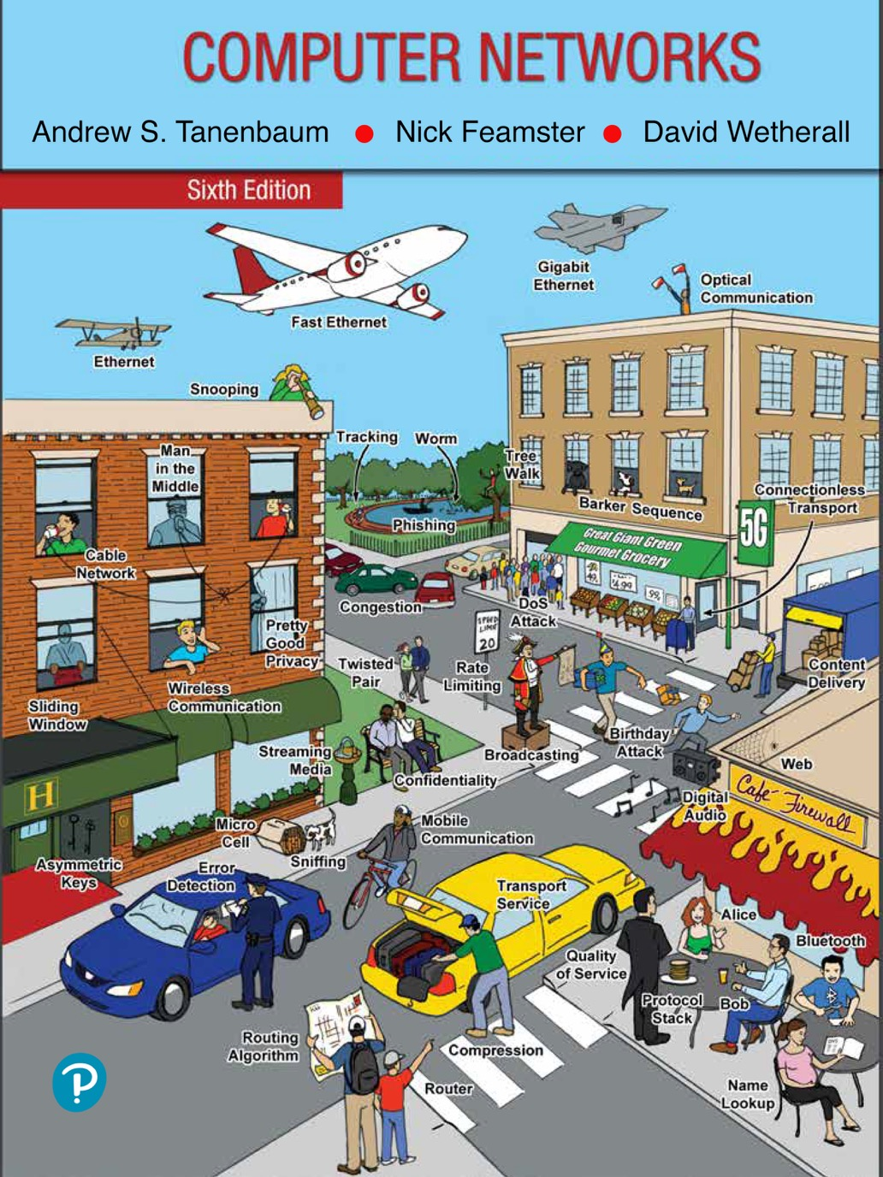
Chapter 2
The Physical Layer

Slide 2
Guided Transmission Media
Guided transmission media
Persistent storage
Twisted pairs
Coaxial cable
Power lines
Fiber optics

Slide 3
Persistent Storage
Consists of magnetic or solid-state storage
Common way to transport data
Write to persistent storage
Physically transport the tape or disks to the destination machine
Read data back again
Cost effective for applications where a high data rate or cost per bit transported is the key factor
Never underestimate the bandwidth of a station wagon full of tapes hurtling down the highway

Slide 4
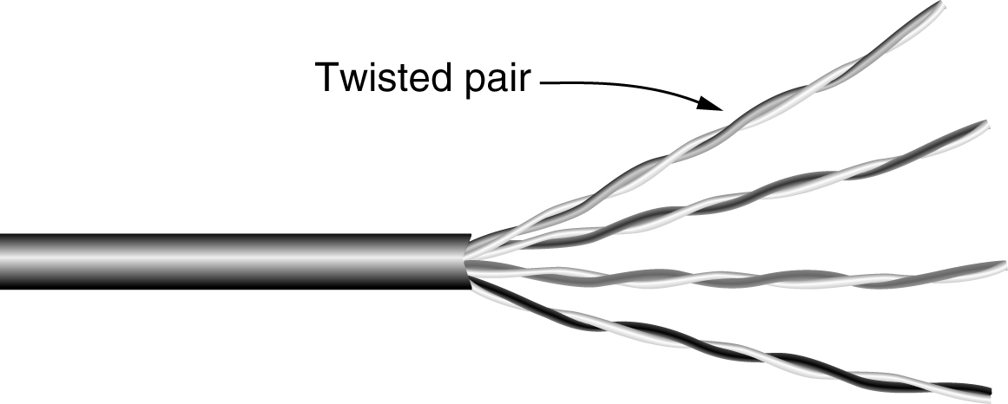
Twisted Pairs
A category 5e twisted pair consists of two insulated wires gently twisted together. Four such pairs are typically grouped in a plastic sheath to protect the wires and keep them together.

Slide 5
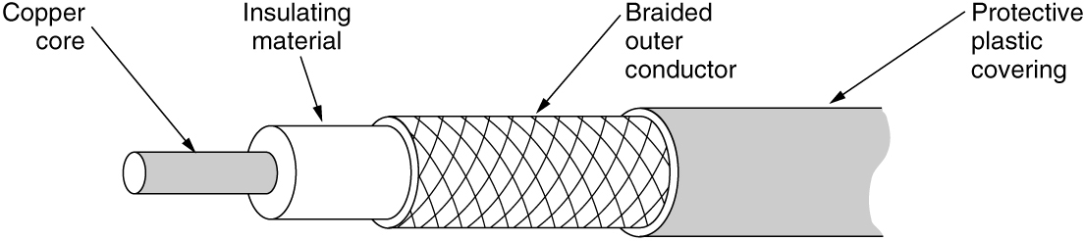
Coaxial Cable
A coaxial cable consists of a stiff copper wire as the core, surrounded by an insulating material. The insulator is encased by a cylindrical conductor, often as a closely woven braided mesh. The outer conductor is covered in a protective plastic sheath.

Slide 6
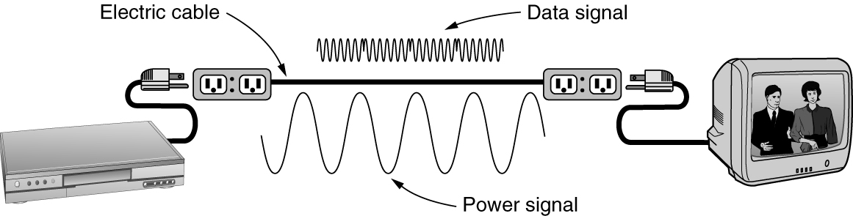
Power Lines
Using power lines for networking is simple. In this case, a TV and a receiver are plugged into the wall, which must be done anyway because they need power. Then they can send and receive movies over the electrical wiring.

Slide 7
Fiber Optics (1 of 7)
Allows essentially infinite bandwidth
Must consider costs
For installation over the last mile and to move bits
Uses
Long-haul transmission in network backbones
High-speed LANs
High-speed Internet access
Key components
Light source, transmission medium, and detector
Transmission system uses physics

Slide 8
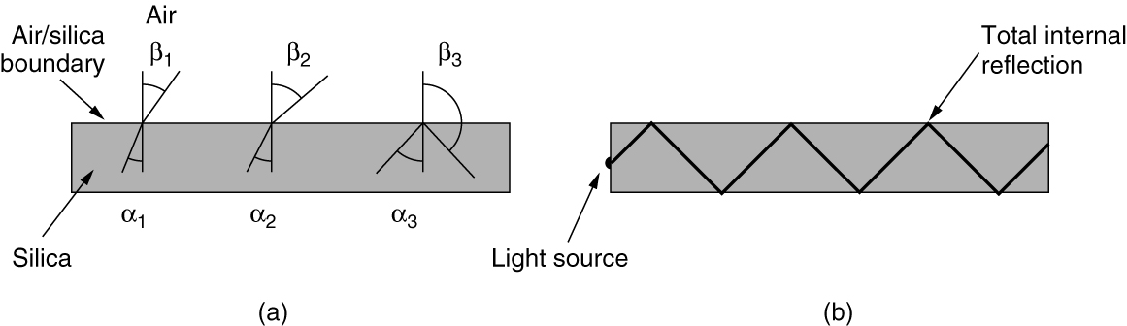
Fiber Optics (2 of 7)
Figure (a) illustrates a light ray inside a silica fiber impinging on the air/silica boundary at different angles. Figure (b) illustrates light trapped by total internal reflection.

Slide 9
Fiber Optics (3 of 7)
Transmission of light through fiber
Attenuation of light through glass
Dependent on the wavelength of the light
Defined as the ratio of input to output signal power
Fiber cables
Similar to coax, except without the braid
Two kinds of signaling light sources
LEDs (Light Emitting Diodes)
Semiconductor lasers

Slide 10
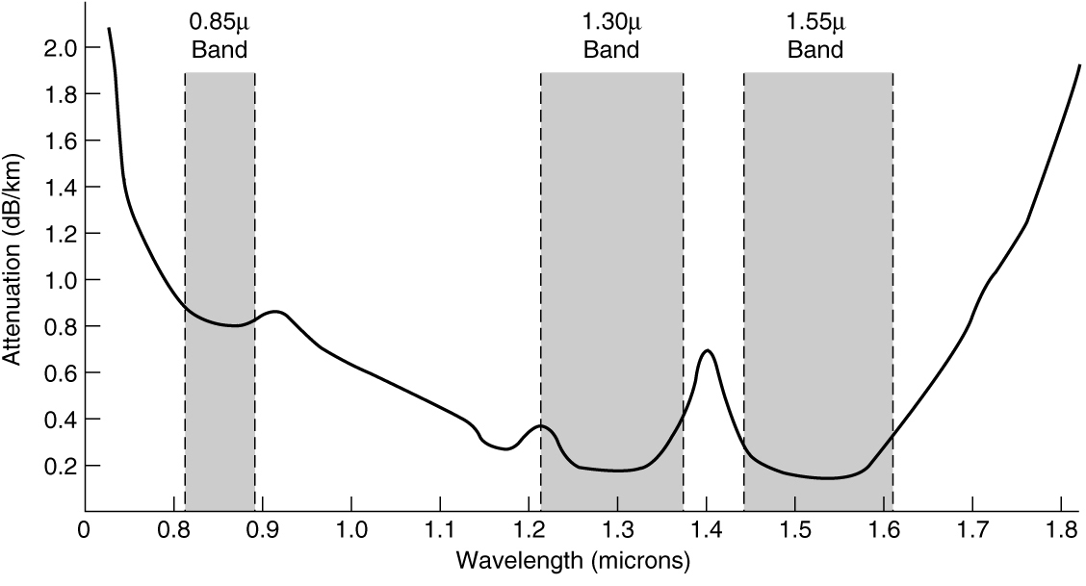
Fiber Optics (4 of 7)
Attenuation of light through fiber in the infrared region is measured in units of decibels (dB) per linear kilometer of fiber.

Slide 11
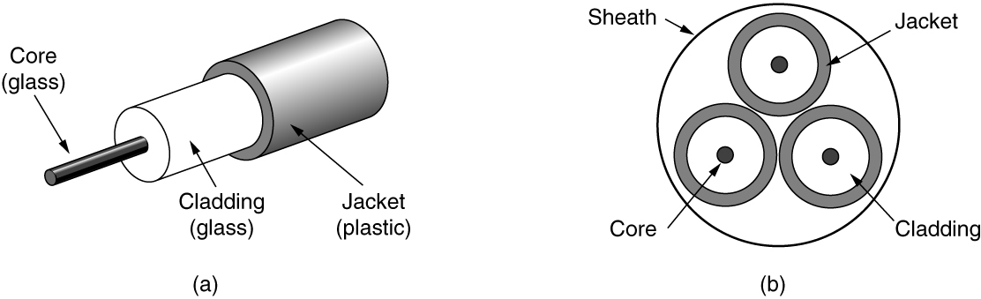
Fiber Optics (5 of 7)
Views of a fiber cable

Slide 12
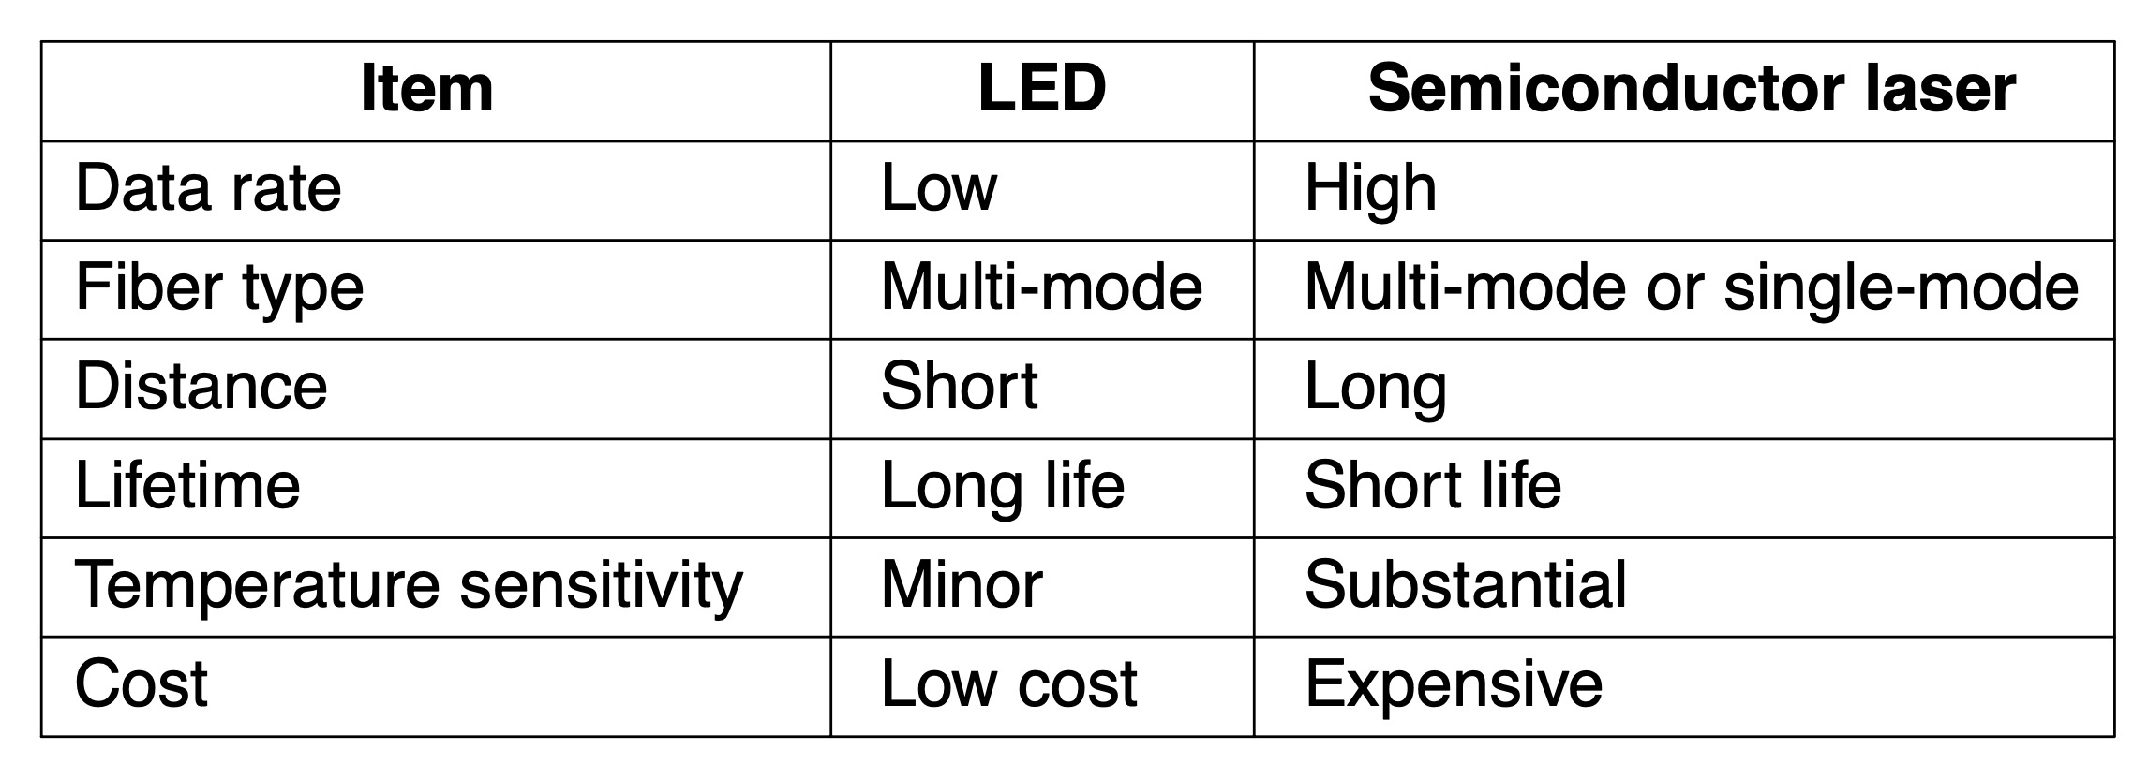
Fiber Optics (6 of 7)
A comparison of semiconductor diodes and LEDs as light sources.

Slide 13
Fiber Optics (7 of 7)
Fiber advantages over copper
Handles higher bandwidth
Not affected by power surges, electromagnetic interference, power failures, corrosive chemicals
Thin and lightweight
Do not leak light
Difficult to tap
Fiber disadvantage
Less familiar technology that requires specific engineering skills
Fibers damaged easily by being bent too much

Slide 14
Wireless Transmission
The electromagnetic spectrum
Modulate wave amplitude, frequency, or phase
Frequency hopping spread spectrum
Transmitter hops from frequency to frequency hundreds of times per second
Direct sequence spread spectrum
Code sequence spreads data signal over wider frequency band
Ultra-wideband communication
Communication sends a series of low-energy rapid pulses, varying their carrier frequencies to communicate information

Slide 15
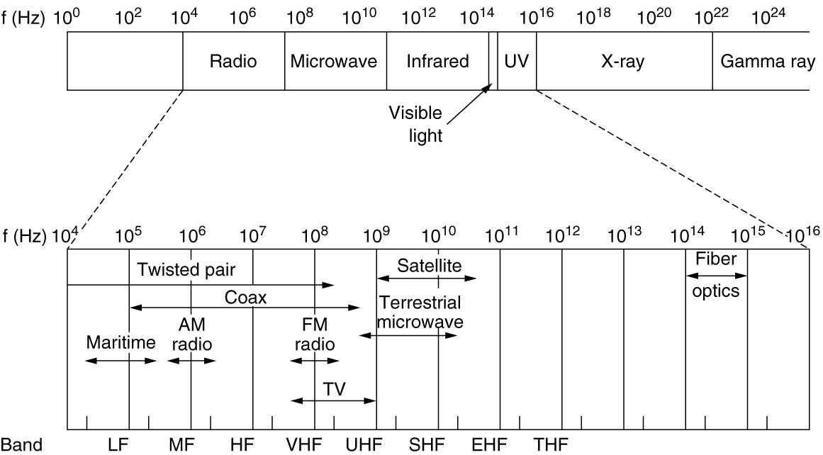
The Electromagnetic Spectrum
The electromagnetic spectrum and its uses for communication.

Slide 16
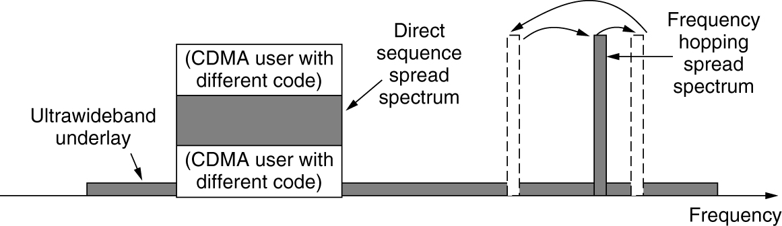
Direct Sequence Spread Spectrum
Direct sequence spread spectrum uses a code sequence to spread the data signal over a wider frequency band.

Slide 17
Using the Spectrum for Transmission
Radio transmission
Omnidirectional waves, easy to generate, travel long distances, penetrate buildings
Microwave transmission
Directional waves requiring repeaters, do not penetrate buildings
Infrared transmission
Unguided waves used for short-range communication, relatively directional, cheap, easy to build, do not penetrate solid walls
Light transmission
Unguided optical communication

Slide 18
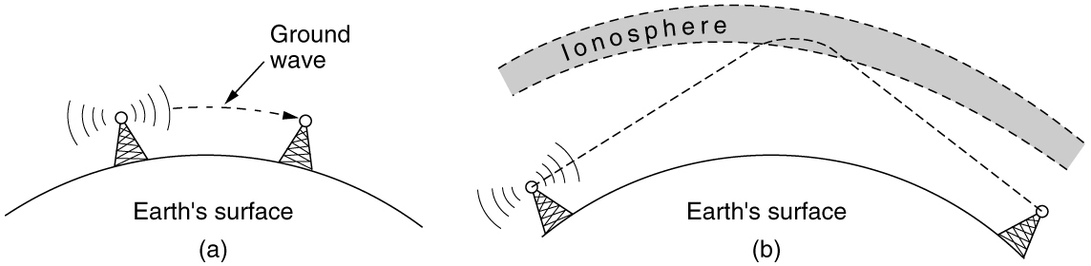
Radio Transmission
In the VLF, LF, and MF bands, radio waves follow the curvature of the earth. In the HF band, they bounce off the ionosphere.

Slide 19
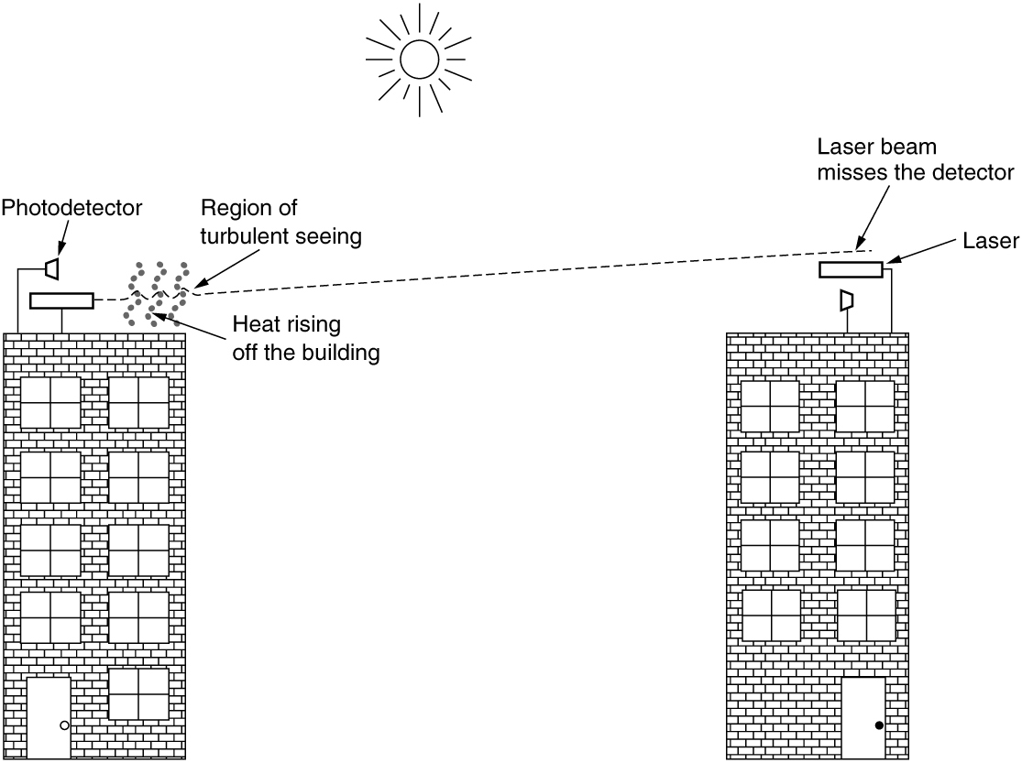
Light Transmission
Convection currents can interfere with laser communication systems. A bidirectional system with two lasers is pictured here.

Slide 20
From Waveforms to Bits
The theoretical basis for data communication
Fourier analysis
Bandwidth-limited signals
The maximum data rate of a channel
Digital modulation
Multiplexing

Slide 21
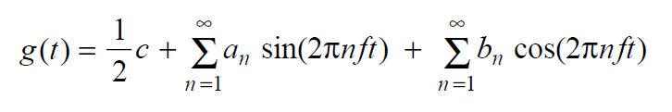
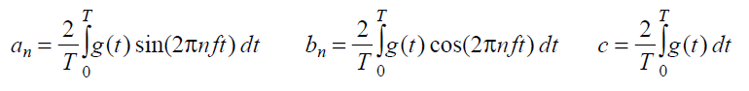
Fourier Analysis
We model the behavior of variation of voltage or current with mathematical functions
Fourier series is used
Function reconstructed with

Slide 22
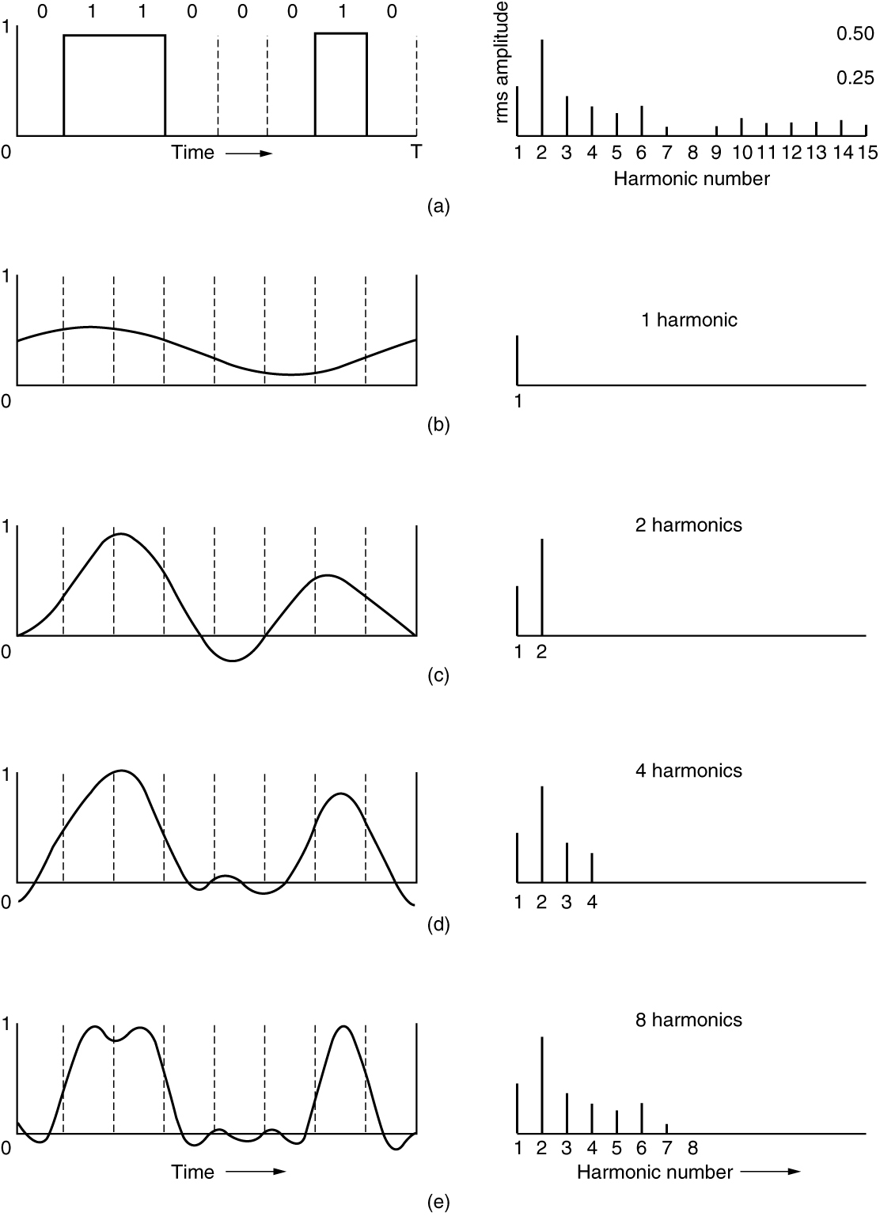
Bandwidth-Limited Signals (1 of 2)
A binary signal and its root-mean-square Fourier amplitudes. This is followed by successive approximations to the original signal.

Slide 23
Bandwidth-Limited Signals (2 of 2)
The relation between data rate and harmonics for our example.

Slide 24
The Maximum Data Rate of a Channel
Nyquist’s theorem
Maximum data rate = 2Blog₂ V bits/sec
Shannon’s formula for capacity of a noisy channel
Maximum data rate = Blog₂ (1 + S/N)bits/sec

Slide 25
Digital Modulation
Baseband transmission
Bandwidth efficiency
Clock recovery
Balanced signals
Passband transmission

Slide 26
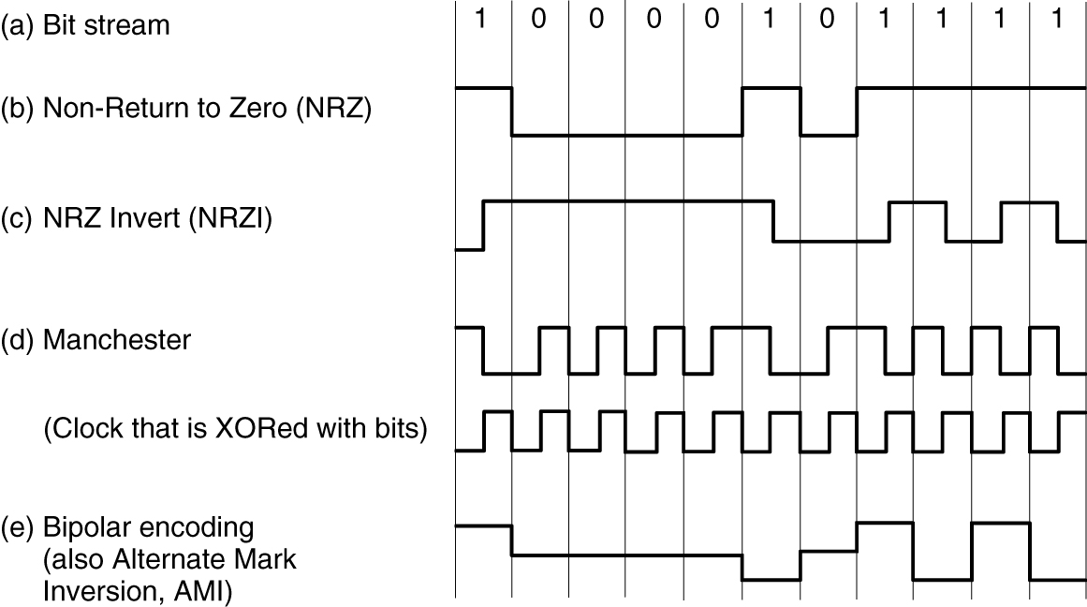
Baseband Transmission
Line codes: (a) Bits, (b) NRZ, (c) NRZI, (d) Manchester, (e) Bipolar or AMI.

Slide 27
Bandwidth Efficiency
Bandwidth is often a limited resource
Solution
Use more than two signaling levels
By using four voltages we can send 2 bits at once as a single symbol
Design works as long as the signal at the receiver is sufficiently strong to distinguish the four levels
Signal rate change is half the bit rate, so the needed bandwidth has been reduced

Slide 28
Clock Recovery
4B/5B mapping.

Slide 29
Balanced Signals
Balanced signals
Signals having as much positive voltage as negative voltage even over short periods of time
They average to zero (they have no DC electrical component)
Balancing helps to provide transitions for clock recovery
Provides a simple way to calibrate receivers
Straightforward way to construct a balanced code
Use two voltage levels to represent a logical 1 and a logical zero
Scheme is called is called bipolar encoding
Bipolar encoding adds a voltage level to achieve balance

Slide 30
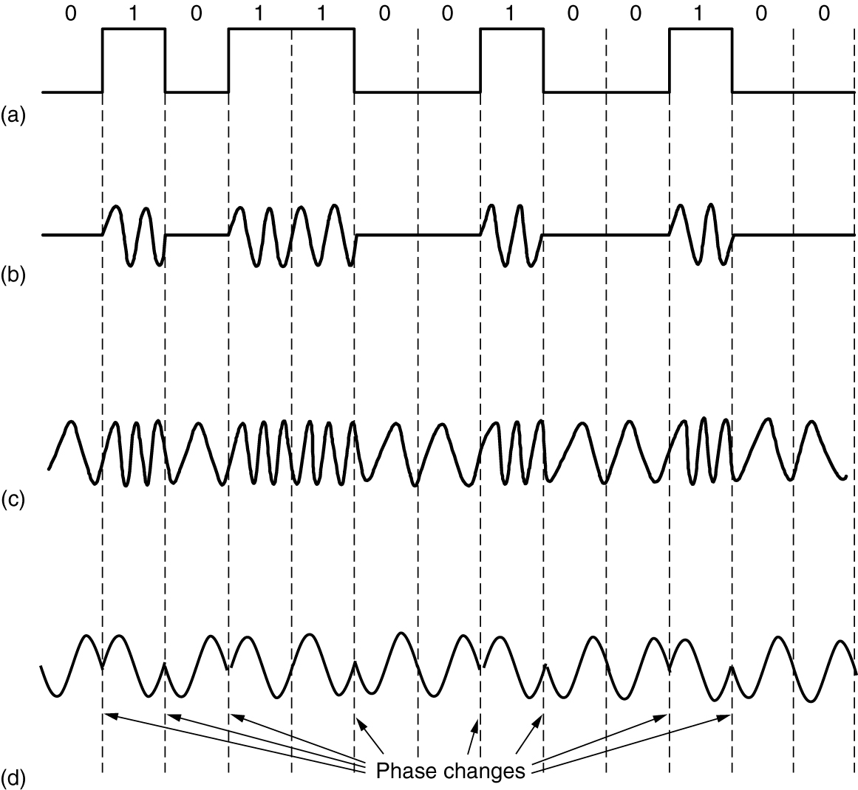
Passband Transmission (1 of 3)
(a) A binary signal. (b) Amplitude shift keying. (c) Frequency shift keying. (d) Phase shift keying.

Slide 31
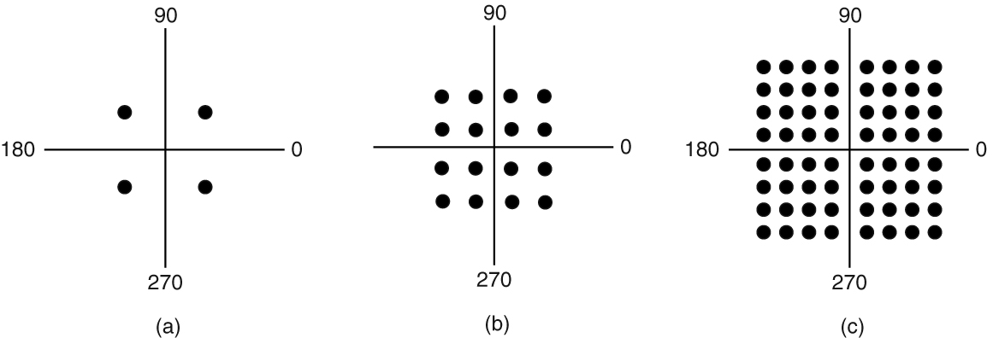
Passband Transmission (2 of 3)
(a) QPSK. (b) QAM-16. (c) QAM-64.

Slide 32
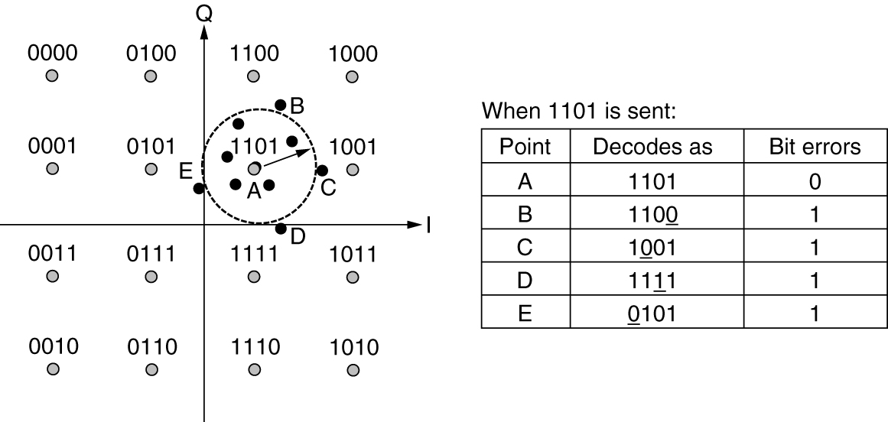
Passband Transmission (3 of 3)
Gray-coded QAM-16

Slide 33
Multiplexing
Frequency Division Multiplexing
Time Division Multiplexing
Code Division Multiplexing
Wavelength Division Multiplexing

Slide 34
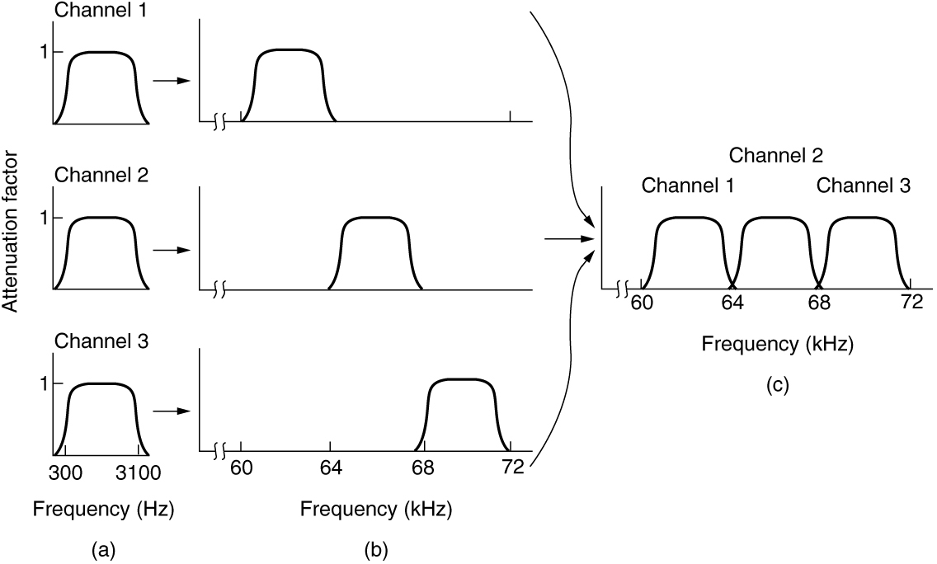
Frequency Division Multiplexing (1 of 2)
(a) The original bandwidths. (b) The bandwidths raised in frequency. (c) The multiplexed channel.

Slide 35
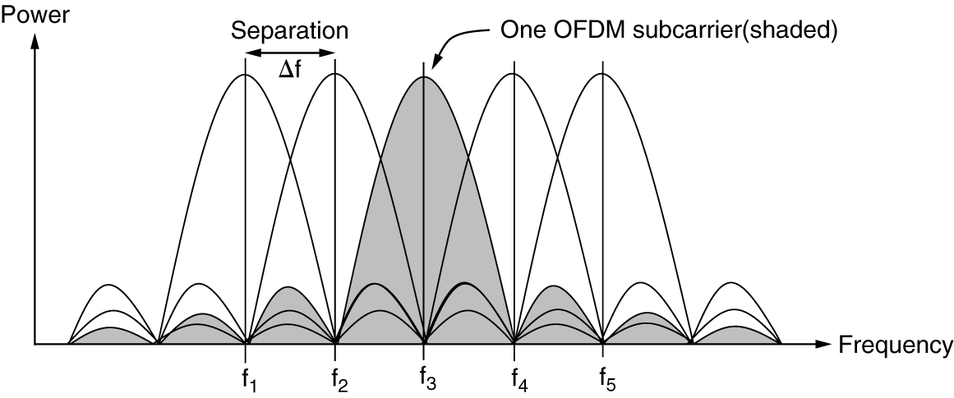
Frequency Division Multiplexing (2 of 2)
Orthogonal frequency division multiplexing (OFDM).

Slide 36
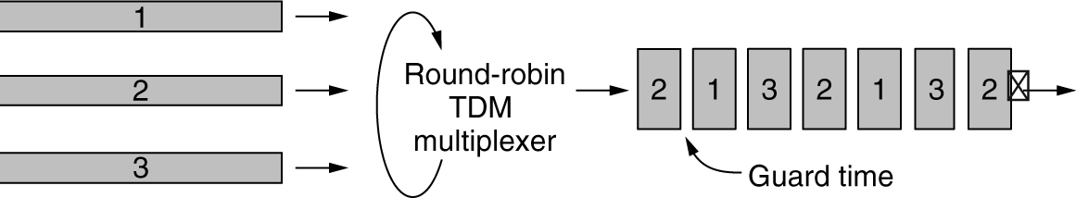
Time Division Multiplexing
Time Division Multiplexing (TDM)

Slide 37
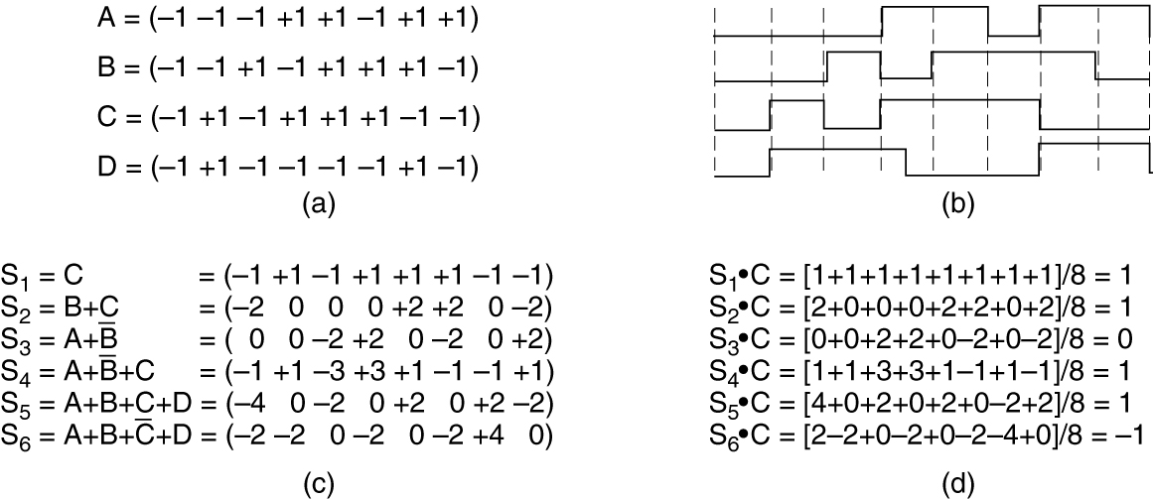
Code Division Multiplexing
(a) Chip sequences for four stations. (b) Signals the sequences represent. (c) Six examples of transmissions. (d) Recovery of station C’s signal.

Slide 38
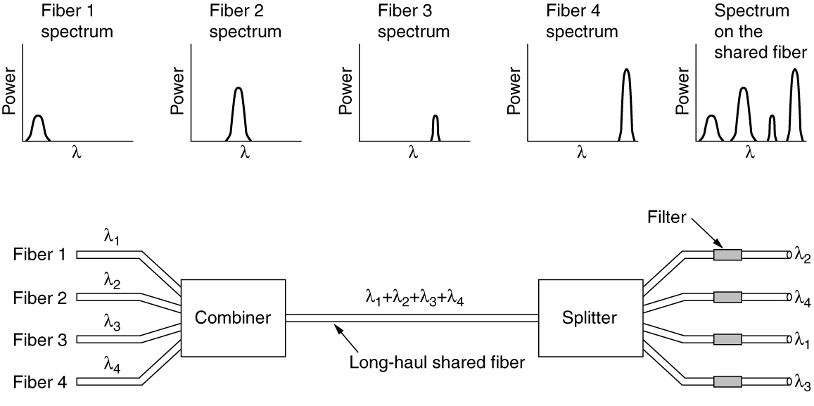
Wavelength Division Multiplexing
Wavelength division multiplexing

Slide 39
The Public Switched Telephone Network
Structure of the Telephone System
The Local Loop: Telephone Modems, ADSL, and Fiber
Telephone modems

Slide 40
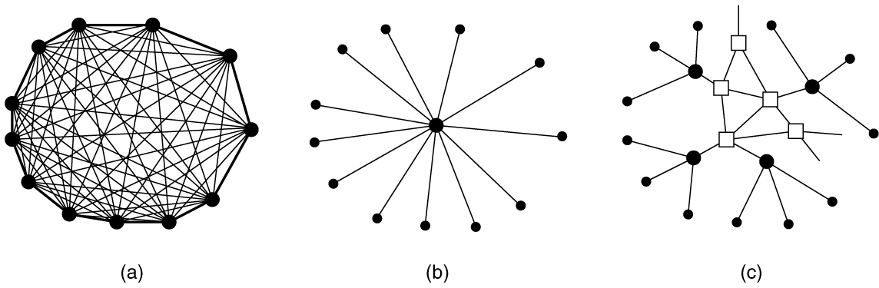
Structure of the Telephone System (1 of 2)
(a) Fully interconnected network. (b) Centralized switch. (c) Two-level hierarchy.

Slide 41
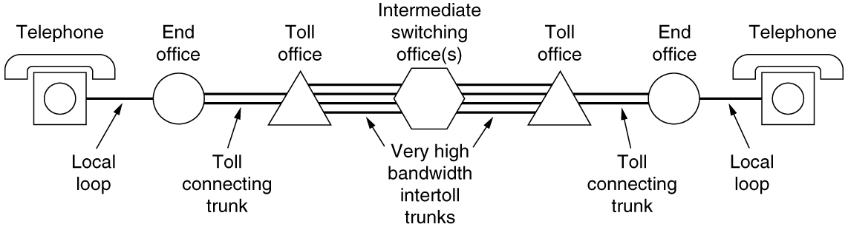
Structure of the Telephone System (2 of 2)
A typical circuit route for a long-distance call.

Slide 42
The Local Loop: Telephone Modems, ADSL, and Fiber
Telephone Modems
Digital Subscriber Lines (DSL)
Fiber To The X (FTTX)

Slide 43
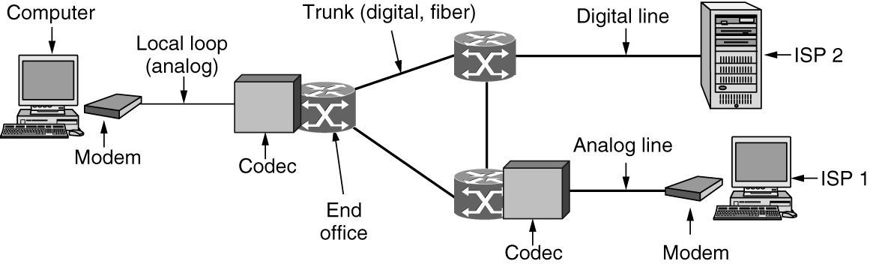
Telephone Modems (1 of 2)
The use of both analog and digital transmission for a computer-to-computer call. Conversion is done by the modems and codecs.

Slide 44
Telephone Modems (2 of 2)
Some modem standards and their bit rate.

Slide 45
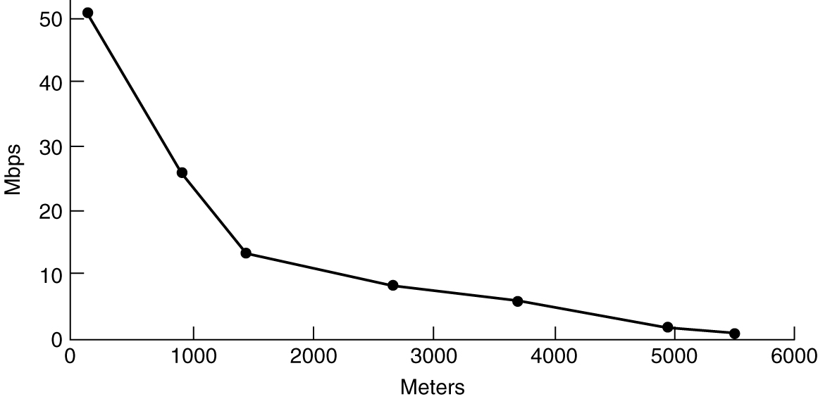
Digital Subscriber Lines (DSL) (1 of 3)
Bandwidth versus distance over Category 3 UTP for DSL.

Slide 46
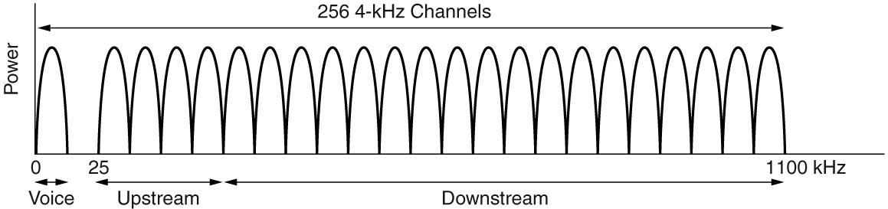
Digital Subscriber Lines (DSL) (2 of 3)
Operation of ADSL using discrete multitone modulation.

Slide 47
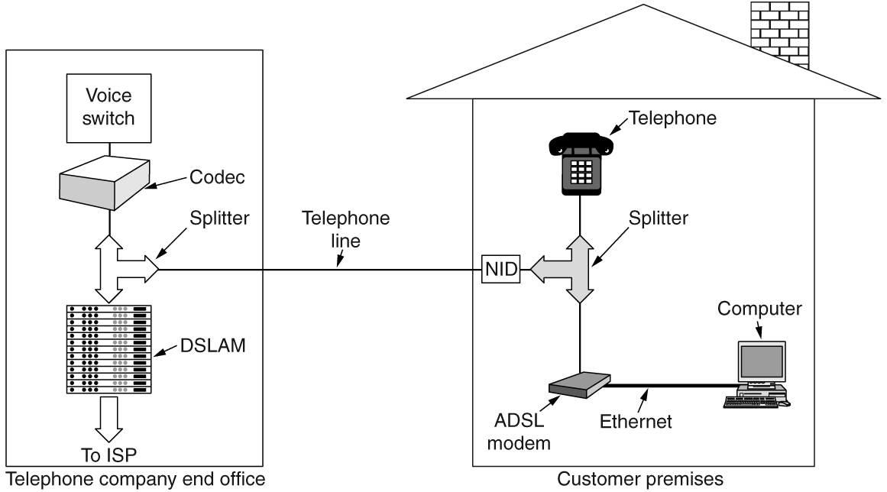
Digital Subscriber Lines (DSL) (3 of 3)
A typical ADSL equipment configuration.

Slide 48
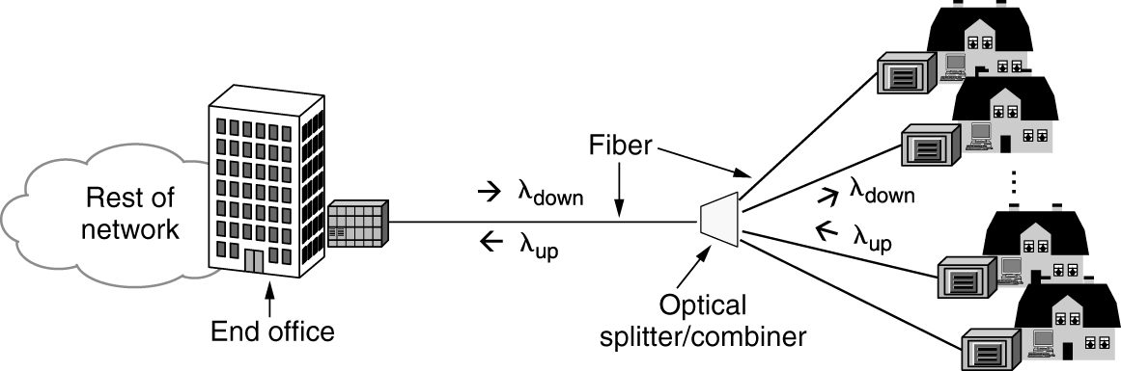
Fiber To The X (FTTX)
Passive optical network for Fiber To The Home.

Slide 49
Trunks and Multiplexing
Digitizing Voice Signals
T-Carrier: Multiplexing Digital Signals on the Phone Network
Multiplexing Optical Networks: SONET/SDH

Slide 50
Digitizing Voice Signals
TDM technique in widespread use today
Conversion from analog to digital in the end office is needed
Use a codec to digitize analog signals
PCM (Pulse Code Modulation) technique used
Each sample of the amplitude of the signal is quantized to an 8-bit number
Two versions of quantization are used: μ-law and A-law
Companding
Compressing the dynamic range of the signal before it is (evenly) quantized
Expanding it when the analog signal is recreated
Analog signal recreated from the quantized samples by playing them out (and smoothing them) over time

Slide 51
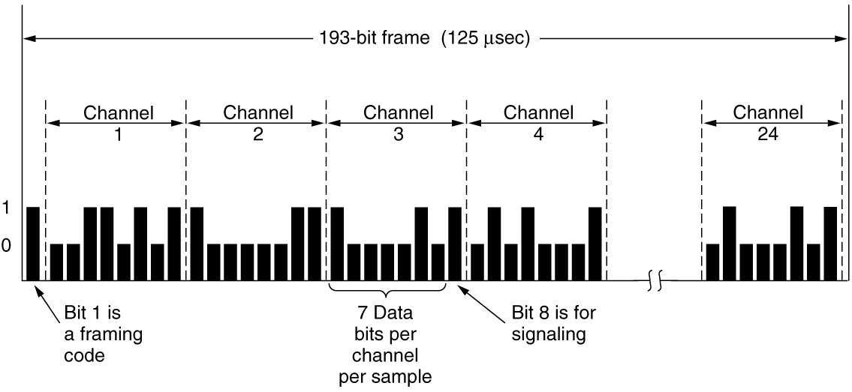
T-Carrier: Multiplexing Digital Signals on the Phone Network (1 of 2)
The T1 carrier (1.544 Mbps).

Slide 52
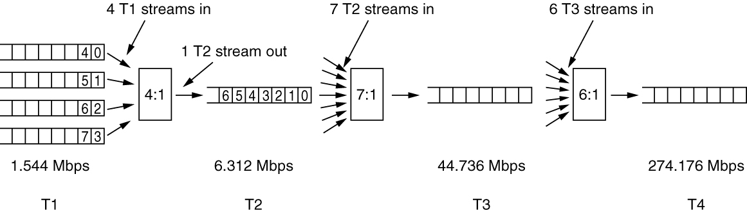
T-Carrier: Multiplexing Digital Signals on the Phone Network (2 of 2)
Multiplexing T1 streams into higher carriers.

Slide 53
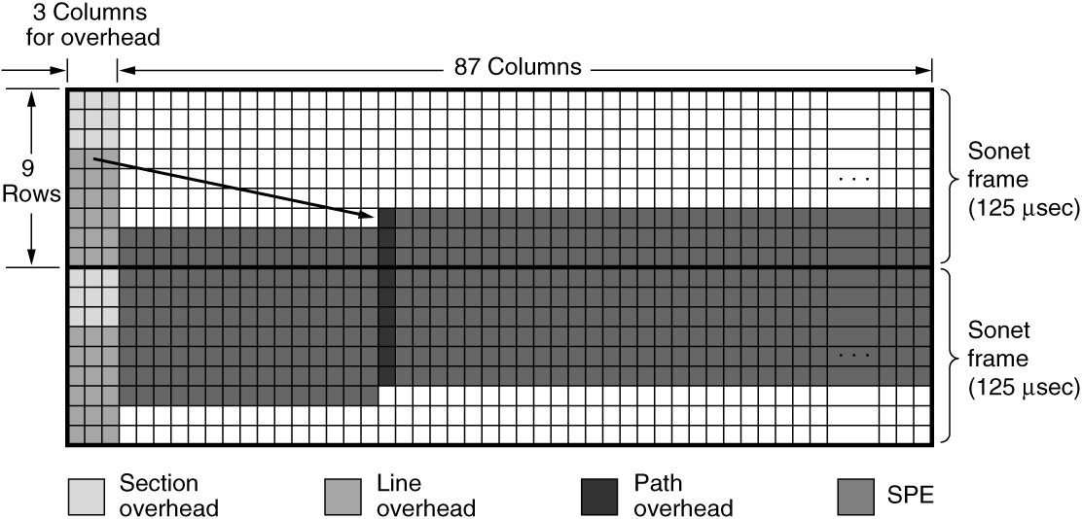
Multiplexing Optical Networks: SONET/SDH (1 of 2)
Two back-to-back SONET frames.

Slide 54
Multiplexing Optical Networks: SONET/SDH (2 of 2)
SONET and SDH multiplex rates.

Slide 55
Switching
Phone system principal parts
Outside plant (outside switching offices)
Inside plant (inside switching offices)
Two different switching techniques
Circuit switching: traditional telephone system
Packet switching: voice over IP technology

Slide 56
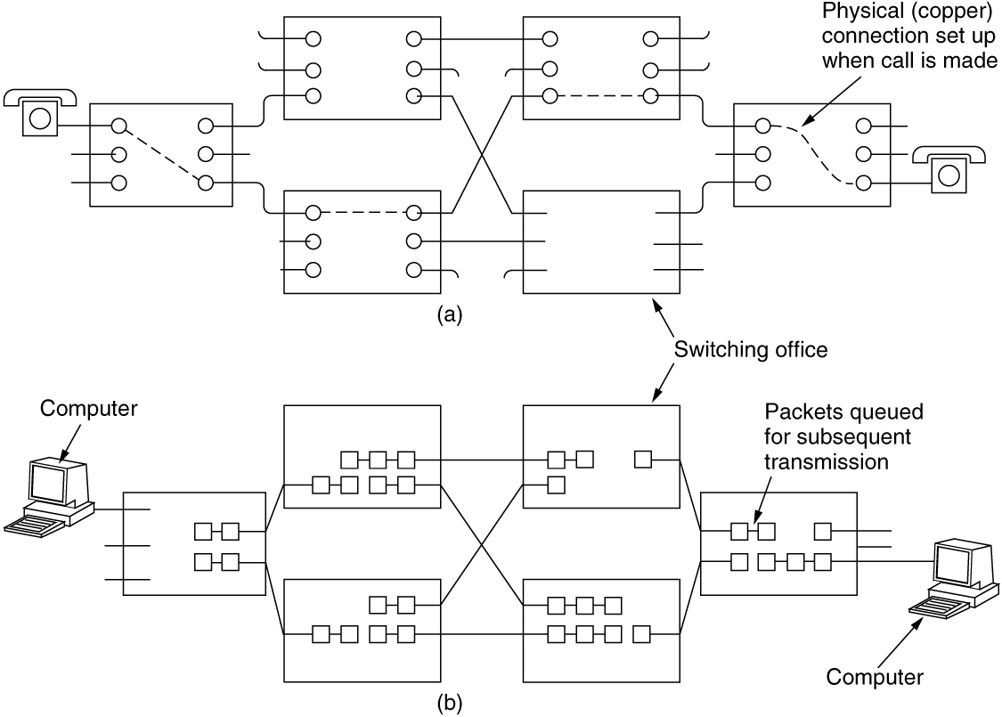
Circuit Switching (1 of 2)
(a) Circuit switching. (b) Packet switching.

Slide 57
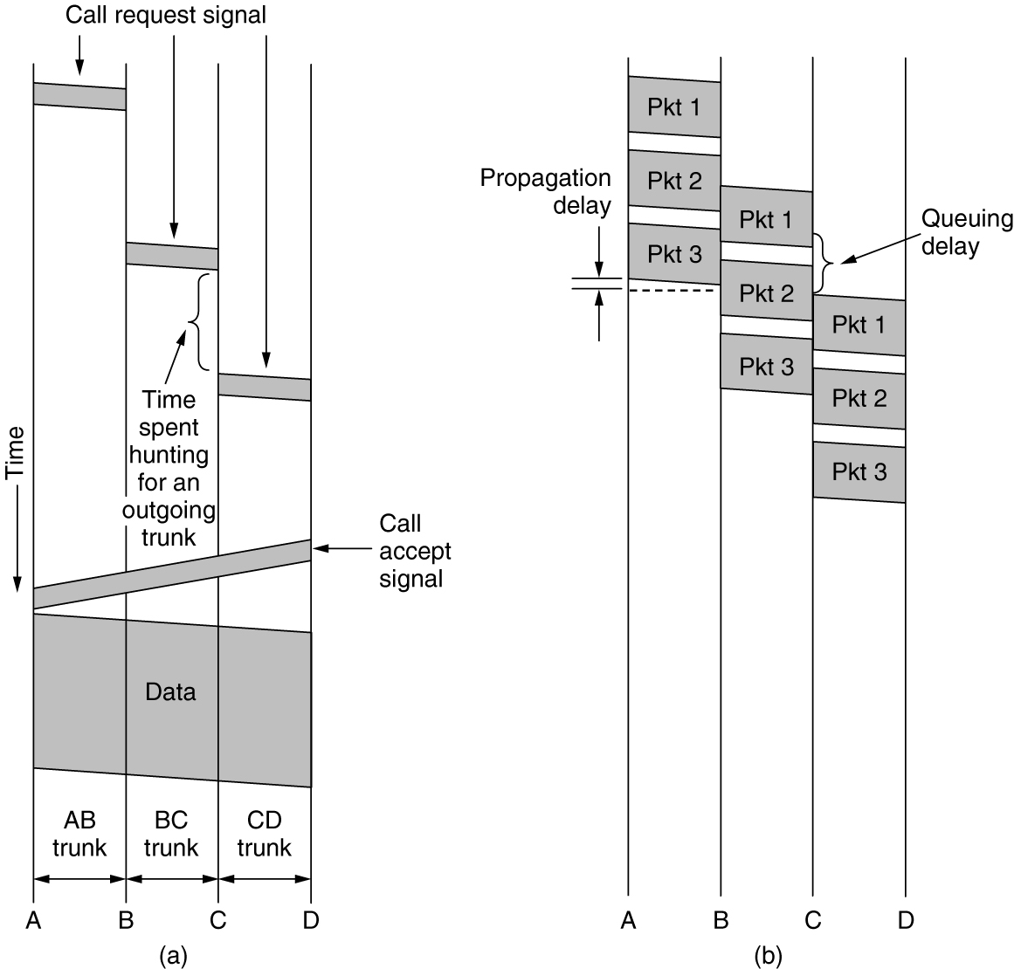
Circuit Switching (2 of 2)
Timing of events in (a) circuit switching, (b) packet switching.

Slide 58
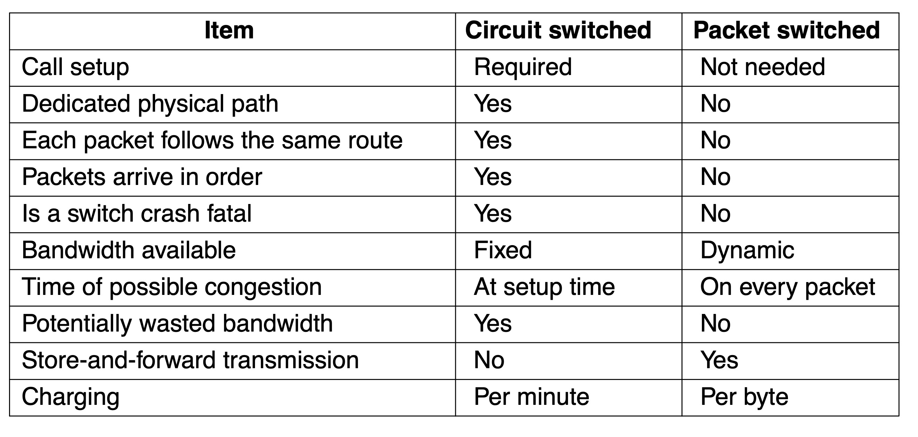
Packet Switching
A comparison of circuit-switched and packet-switched networks.

Slide 59
Cellular Networks
Mobile phone distinct generations
The initial three generations: 1G, 2G, 3G
Provided analog voice, digital voice, and both digital voice and data (Internet, email, etc.) respectively
4G technology adds capabilities
Physical layer transmission techniques and IP-based femtocells
4G is based on packet switching only (no circuit switching)
5G being rolled out now
Supports up to 20 Gbps transmissions and denser deployments
Focus on reducing network latency

Slide 60
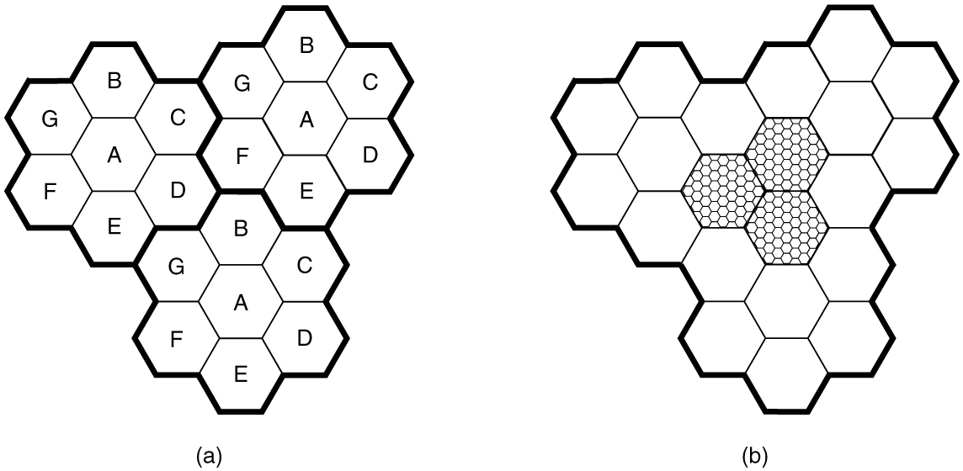
Common Concepts: Cells, Handoff, Paging
(a) Frequencies are not reused in adjacent cells. (b) To add more users, smaller cells can be used.

Slide 61
First-Generation (1G) Technology: Analog Voice
1946 push to talk systems
1960 IMTS (Improved Mobile Telephone System)
Two frequencies: one for sending, one for receiving
1983 AMPS (Advanced Mobile Phone System)
Analog mobile phone system
Cells are typically 10 to 20 km across
Used FDM to separate channels
832 full-duplex channels that consist of a pair of simplex channels used (Frequency Division Duplex)
Each simplex channel is 30 kHz wide
832 channels in AMPS are divided into four categories

Slide 62
Call Management
Outgoing calls
Phone switched on, number entered, CALL button hit
Phone transmits called number and its own identity on the access channel
Base informs the MSC and MSC looks for a channel for the call
Incoming calls
Idle phones continuously listen to the paging channel to detect messages directed at them
Packet sent to base station in the current cell as a broadcast on the paging channel
The called phone responds on the access channel
Called phone switches to channel and starts ringing sound

Slide 63
Second-Generation (2G) Technology: Digital Voice
Digital advantages
Provides capacity gains by allowing voice signals to be digitized and compressed
Improves security by allowing voice and control signals to be encrypted
Deters fraud and eavesdropping, whether from intentional scanning or echoes of other calls due to RF propagation
Enables new services such as text messaging
Three systems developed
D-AMPS (Digital Advanced Mobile Phone System)
GSM (Global System for Mobile communications)
CDMA (Code Division Multiple Access)

Slide 64
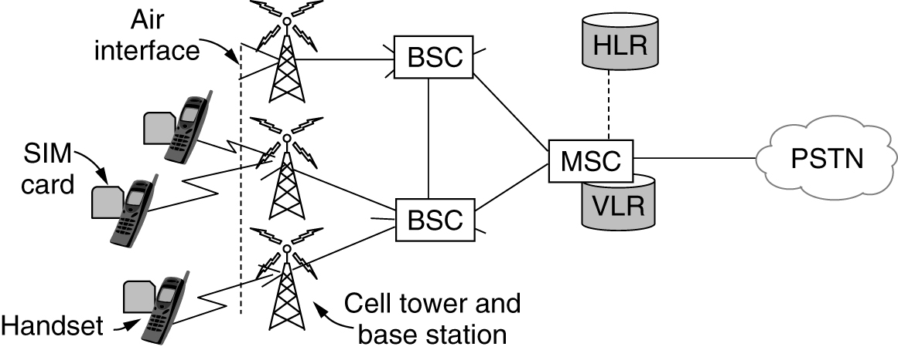
GSM: The Global System for Mobile Communications (1 of 3)
GSM mobile network architecture.

Slide 65
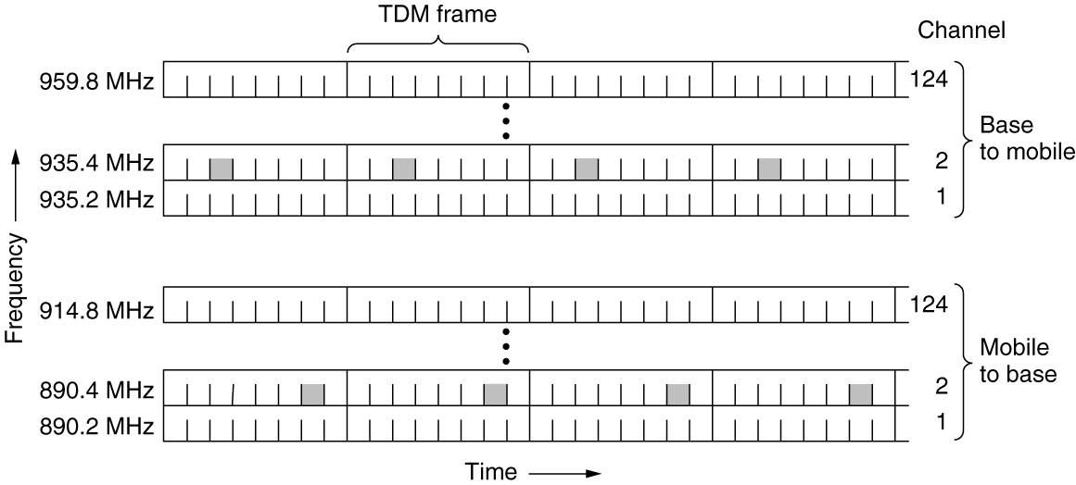
GSM: The Global System for Mobile Communications (2 of 3)
GSM uses 124 frequency channels, each of which uses an eight-slot TDM system.

Slide 66
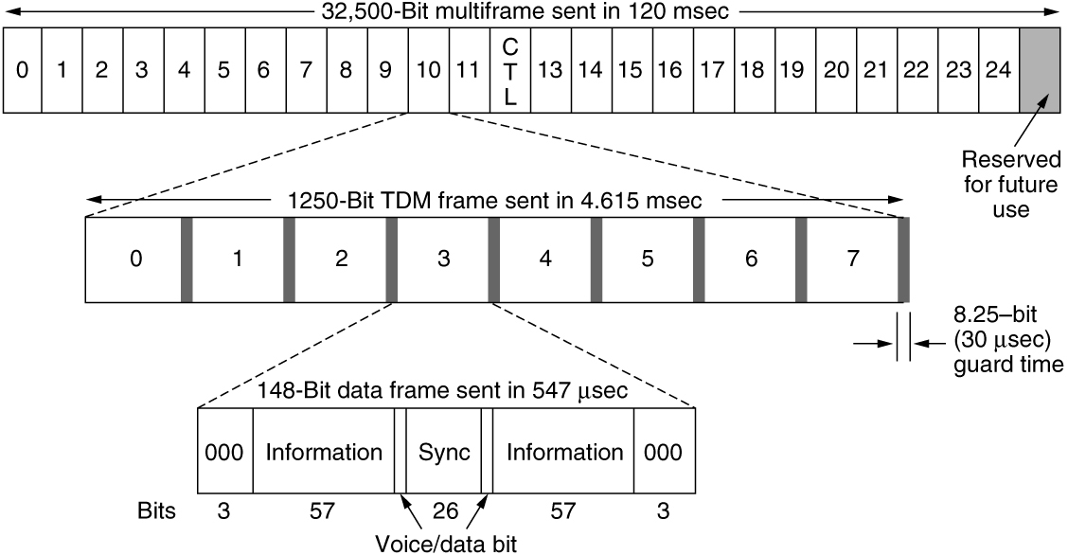
GSM: The Global System for Mobile Communications (3 of 3)
A portion of the GSM framing structure.

Slide 67
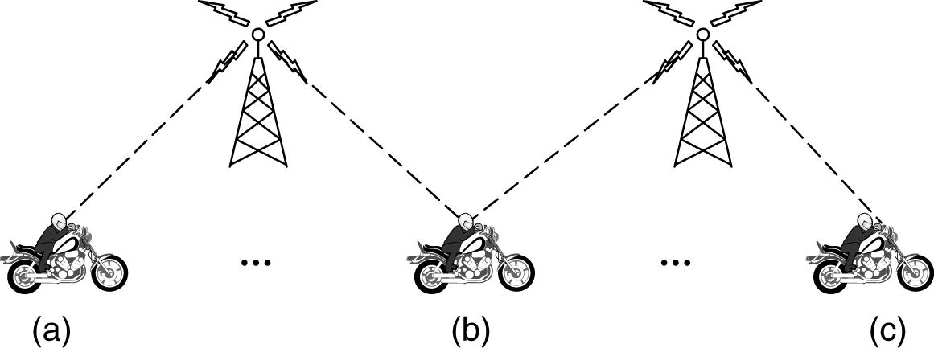
Third-Generation (3G) Technology: Digital Voice and Data
Soft handoff (a) before, (b) during, and (c) after.

Slide 68
Fourth-Generation (4G) Technology: Packet Switching
Also called IMT Advanced
Based completely on packet-switched technology
EPC (Evolved Packet Core) allows packet switching
Simplified IP network separating voice traffic from the data network
Carries both voice and data in IP packets
Voice over IP (VoIP) network with resources allocated using the statistical multiplexing approaches
The EPC must manage resources in such a way that voice quality remains high in the face of network resources that are shared among many users

Slide 69
Fifth-Generation (5G) Technology
Two main factors
Higher data rates and lower latency than 4G technologies
Technology used to increase network capacity
Ultra-densification and offloading
Increased bandwidth with millimeter waves
Increased spectral efficiency through advances in massive MIMO (Multiple-Input Multiple-Output) technology
Network slicing feature
Lets cellular carriers create multiple virtual networks on top of the same shared physical infrastructure
Can devote network portions to specific customer use cases

Slide 70
Cable Networks
Cable networks
Will factor heavily into future broadband access networks
Many people nowadays get their television, telephone, and Internet service over cable
2018 DOCSIS standard
Provides information related to modern cable network architectures

Slide 71
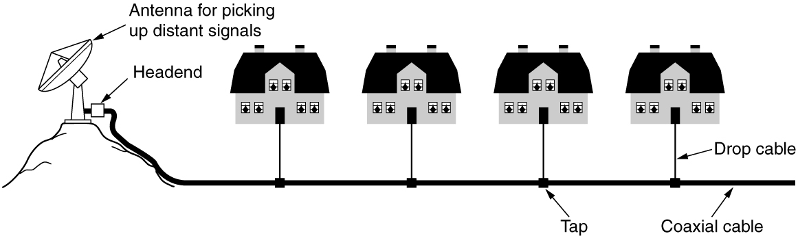
A History of Cable Networks: Community Antenna Television
An early cable television system.

Slide 72
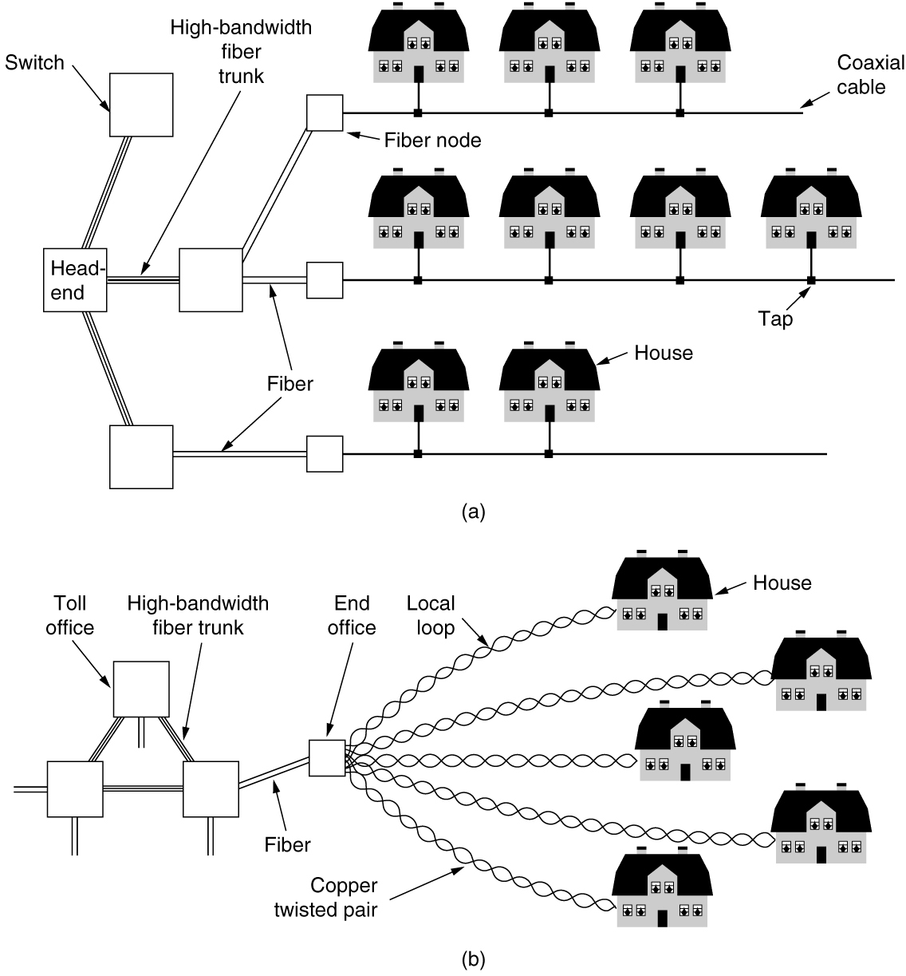
Broadband Internet Access Over Cable: HFC Networks (1 of 2)
(a) Hybrid Fiber-Coax cable network. (b) The fixed phone system.

Slide 73
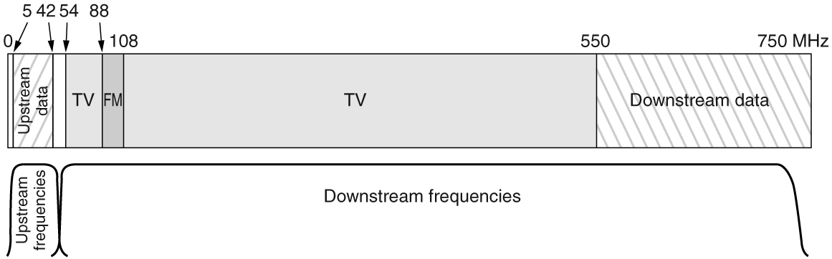
Broadband Internet Access Over Cable: HFC Networks (2 of 2)
Frequency allocation in a typical cable TV system used for Internet access.

Slide 74
DOCSIS
DOCSIS (Data Over Cable Service Interface Specification) 3.1 latest version
Introduced Orthogonal Frequency Division Multiplexing (OFDM)
Introduced wider channel bandwidth and higher efficiency
Enabled over 1 Gbps of downstream capacity per home
Extensions to DOCSIS 3.1
Full Duplex operation (2017) and DOCSIS Low Latency (2018)
Cable Internet subscribers require a DOCSIS cable modem
Modem-to-home network interface: Ethernet connection

Slide 75
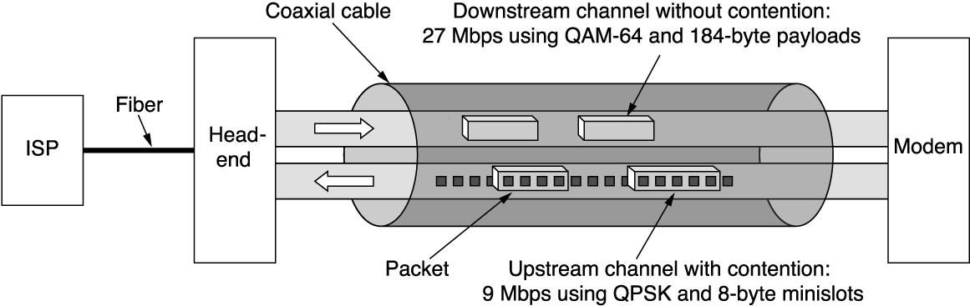
Resource Sharing in DOCSIS Networks: Nodes and Minislots
Typical details of the upstream and downstream channels in North America.

Slide 76
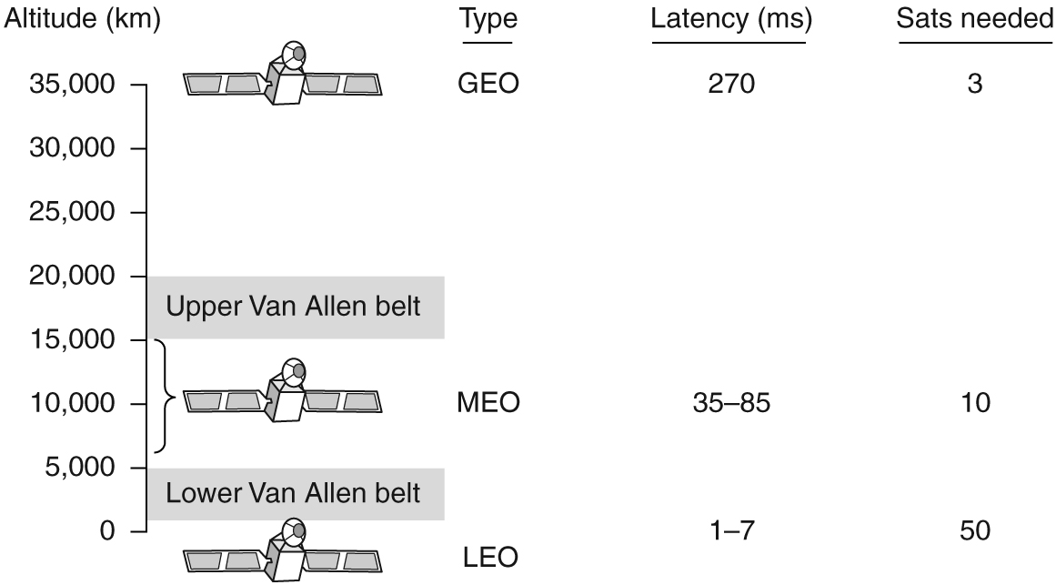
Communication Satellites
Communication satellites and some of their properties, including altitude above the earth, round-trip delay time, and number of satellites needed for global coverage.

Slide 77
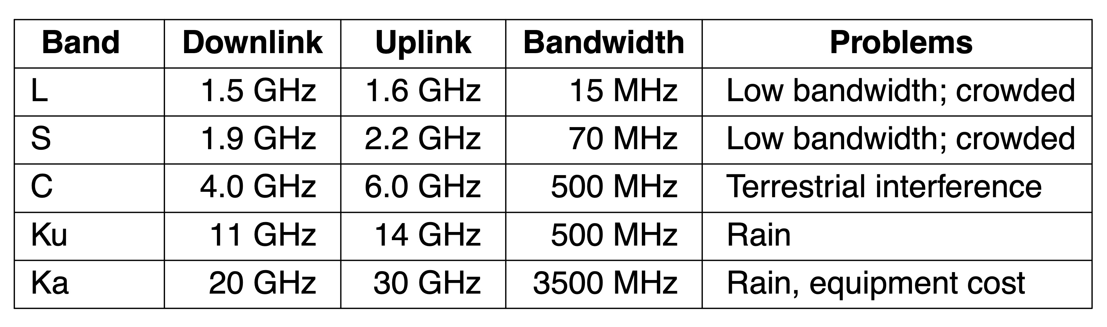
Geostationary Satellites (1 of 2)
The principal satellite bands.

Slide 78
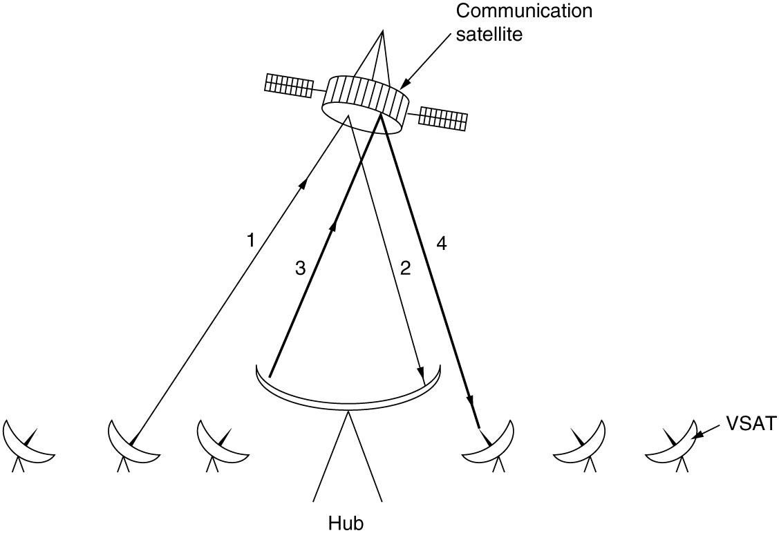
Geostationary Satellites (2 of 2)
VSATs using a hub.

Slide 79
Medium-Earth Orbit Satellites
MEO (Medium-Earth Orbit) satellites
Found at lower altitudes - between the two Van Allen belts
Drift slowly in longitude (6 hours to circle the earth)
Must be tracked as they move through the sky
Have a smaller footprint on the ground
Require less powerful transmitters to reach them
Used for navigation systems
Example:
Constellation of roughly 30 GPS (Global Positioning System) satellites orbiting at about 20,200 km

Slide 80
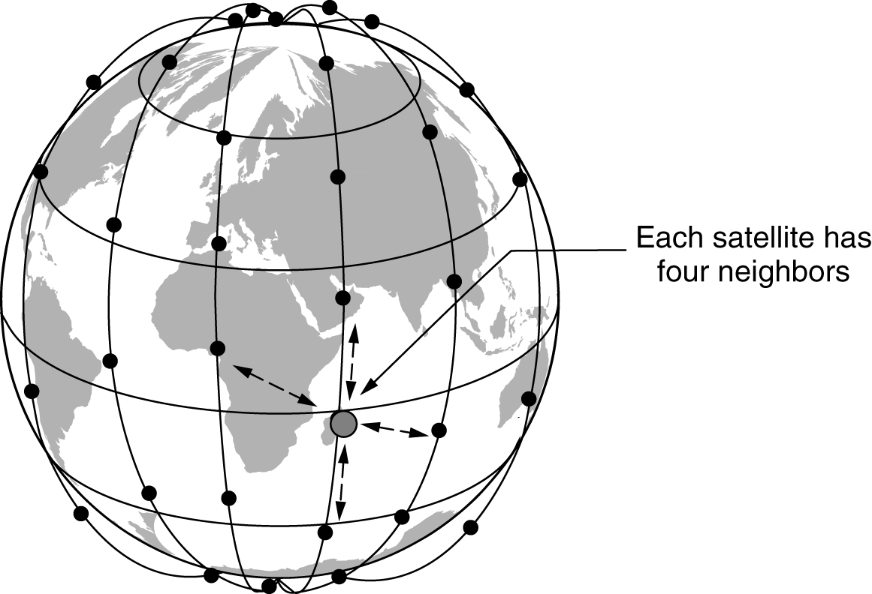
Low-Earth Orbit Satellites (1 of 2)
The Iridium satellites form six necklaces around the earth.

Slide 81

Low-Earth Orbit Satellites (2 of 2)
(a) Relaying in space. (b) Relaying on the ground.

Slide 82
Terrestrial Access Networks: Cable, Fiber, and ADSL
Similarities
Comparable service and comparable prices
Use fiber in the backbone
Differences
Last-mile access technology at the physical and link layers
Bandwidth consistency
Cable subscribers share the capacity of a single node
Maximum speeds
Availability
Security

Slide 83
Satellites Versus Terrestrial Networks
Communication satellites niche markets
Rapid deployments
Places where the terrestrial infrastructure is poorly developed
When broadcasting is essential
United States has some competing satellite-based Internet providers
Satellite Internet access seeing a growing interest
In-flight Internet access

Slide 84

Spectrum Allocation
ISM and U-NII bands used in the United States by wireless devices.

Slide 85
The Cellular Network
Political and tiny marketing decisions can have a huge impact on the deployment of cellular networks
Areas where U.S. and Europe differ
Digital mobile phone systems
Phone numbers
Widespread use of prepaid mobile phones in Europe
Future areas of concern
Auctioning of coveted spectrum bands for 5G
Rise of MVNOs (Mobile Virtual Network Operators)

Slide 86

The Telephone Network
The relationship of LATAs, LECs, and IXCs. All the circles are LEC switching offices. Each hexagon belongs to the IXC whose number is in it.

Slide 87

Copyright
This work is protected by United States copyright laws and is provided solely for the use of instructors in teaching their courses and assessing student learning. Dissemination or sale of any part of this work (including on the World Wide Web) will destroy the integrity of the work and is not permitted. The work and materials from it should never be made available to students except by instructors using the accompanying text in their classes. All recipients of this work are expected to abide by these restrictions and to honor the intended pedagogical purposes and the needs of other instructors who rely on these materials.

